Slide 1

Duty to accommodate
Notes:
Go through any logistics or technical issues (e.g. ways to ask questions, etc)

Slide 2
Learning Objectives
To define the duty to accommodate and recognize when accommodation is needed
To develop an understanding of the responsibilities of the parties with regards to workplace accommodation
To identify where to go for assistance and resources when dealing with workplace accommodation issues
Notes:
Briefly outline the objectives.
Acknowledge that there are varying levels of experience among participants.
As human rights representatives, they may or may not deal with individual cases, but they should have a basic knowledge of DTA if they get questions from members or stewards, or sit on workplace committees dealing with human rights issues.

Slide 3
What experience do you have with DTA?
Notes:
Ask this question and invite BRIEF answers (not details of cases they have dealt with)

Slide 4

What is the duty to accommodate?
Notes:
You can ask briefly what they see as the definition of DTA, then show the video.

Slide 5

What is the duty to accommodate?
Video
https://youtu.be/kGShnVjzq94
Notes:
You can ask briefly what they see as the definition of DTA, then show the video.

Slide 6
What is the duty to accommodate?
The duty to accommodate is the duty of employers to make sure that their workplaces are inclusive and allow all workers to participate fully. This duty relates to the grounds of discrimination in human rights laws.
What does this mean?
The employer must design policies, procedures, requirements, standards and practices so that they do not create barriers to employees’ participation based on human rights grounds.
The employer must adapt the workplace (physical work space or equipment, or workplace rules, practices etc) to ensure that individual workers can fully participate.
Notes:
Talk briefly about the need for inclusivity when designing workplace standards and the Meiorin principles

Slide 7
Who is covered?
Applies to all grounds under human rights laws
Usually includes: race or colour; religion or creed; age; sex or gender; marital Status; disability; sexual orientation; national or ethnic origin; family status; ancestry or place of origin; gender identity and/or gender expression
Notes:
DTA is usually thought of as relating to disability, but really applies to all grounds

Slide 8
Duty to accommodate in practice
If a barrier prevents a worker from fully participating in the workplace, the employer must accommodate to the point of undue hardship
Examples:
designing physical spaces with accessibility in mind for people with different needs
ensuring policies on absences from work are inclusive and flexible enough to adapt to different family obligations or religious requirements
providing an adapted workstation if a worker has disability-related ergonomic needs
allowing a gradual return to work that involves part-time hours for a specified period of time after an employee’s long term absence
Notes:
We know what DTA definition and legal interpretation means, but what does it mean in practice? These are some examples.
Mention cases? E.g. Johnstone,

Slide 9
Responsibilities of the parties
The employer has the primary responsibility
The worker requiring accommodation also has some responsibilities
Unions and other employees have responsibilities as well
Notes:
DTA is a multi-party process. Although employers have the primary responsibility, the worker and union have responsibilities too. Without cooperation from everyone, DTA won’t work.

Slide 10
Responsibilities of the employer
To inform employees and applicants of their right to accommodation
To ensure managers and supervisors are aware of the DTA
To seek necessary information from the worker and union
To review, assess, and follow up on accommodations made
To maintain confidentiality and respect privacy of worker
To respect the collective agreement
To accommodate unless there is undue hardship
Notes:
These are only some of the responsibilities of the employer. For a More exhaustive list, see the DTA guide

Slide 11
Responsibilities of the worker
To request needed accommodations (unless they are unable to)
To provide the necessary information, including medical information related to their limitations and accommodation needs
To collaborate and participate in accommodation process
To accept reasonable offers of accommodation
To provide an explanation if refusing an offer of accommodation
Notes:
Add the following:
Workers (or union) must request accommodation UNLESS the disability prevents them from doing so. Example: a person with depression or anxiety may not ask for fear of stigma but if it’s clear to the employer that the employee’s work is suffering because of what may be a mental health issue, they have a duty to inquire.
Workers have to provide some information. The employer can’t guess what accommodation needs they have and is entitled to evidence to substantiate it. From the union’s perspective, this also ensures that things are well-documented and established in case of a dispute
A worker is not entitled to their “perfect” accommodation. Just because they prefer to work in a specific office or at a specific time does not mean that they can refuse a different accommodation, unless there is a medical reason (or other reason relating to the ground) or health and safety issue, or some other legitimate reason
If the worker has refused, they should provide a very clear reason with documentation to back it up. If a worker refuses a reasonable accommodation without a good reason, an adjudicator may rule that they employer has fulfilled their obligation (and dismiss the case).

Slide 12
Responsibilities of the union
To represent members requiring accommodation
To collaborate with the employer and member and assist in securing the accommodation
To inquire with a member who is having difficulties at work as to whether accommodation is needed
Unions must not discriminate or block an accommodation (unless there would be undue hardship)
To ensure the collective agreement does not discriminate

Slide 13
Others who may be involved in workplace accommodation
Co-workers should understand what the duty to accommodate is and why it is valuable for the whole workplace. But ensure confidentiality and privacy.
Health and safety representatives may be involved in accommodation cases to ensure that health and safety protocols are being respected and new hazards aren’t being created.
Professionals to assess the workplace, the job in question or the worker requiring accommodation.
Notes:
Coworkers should understand and the union can help educate so that they do not view the person as getting “special treatment”. The union should not divulge confidential or sensitive information, unless the worker agrees to do so.
Health and safety is related to DTA. For example, health and safety committees often deal with things like ergonomics in the workplace, various workplace policies, and of course, hazards in the workplace. An accommodation should not create a new hazard for the worker or other workers. However, individual cases of accommodation don’t generally go to health and safety committees, as they are not necessarily equipped or knowledgeable enough about human rights to deal with these.
Ergonomics assessments, job demands analyses, medical examinations, and other professional assessments are often part of an accommodation. The union rep can help to ensure that the professional understands the employer’s duty to accommodate and what types of information the employer needs (if the employer has not already communicated this).

Slide 14
Steps in the accommodation process
Step 1: Need for accommodation arises
Step 2: Information gathering
Step 3: Meeting of the parties
Step 4: Implementation
Step 5: Follow-up and re-assessment
Notes:
Just read out the steps and then click to the next slide

Slide 15
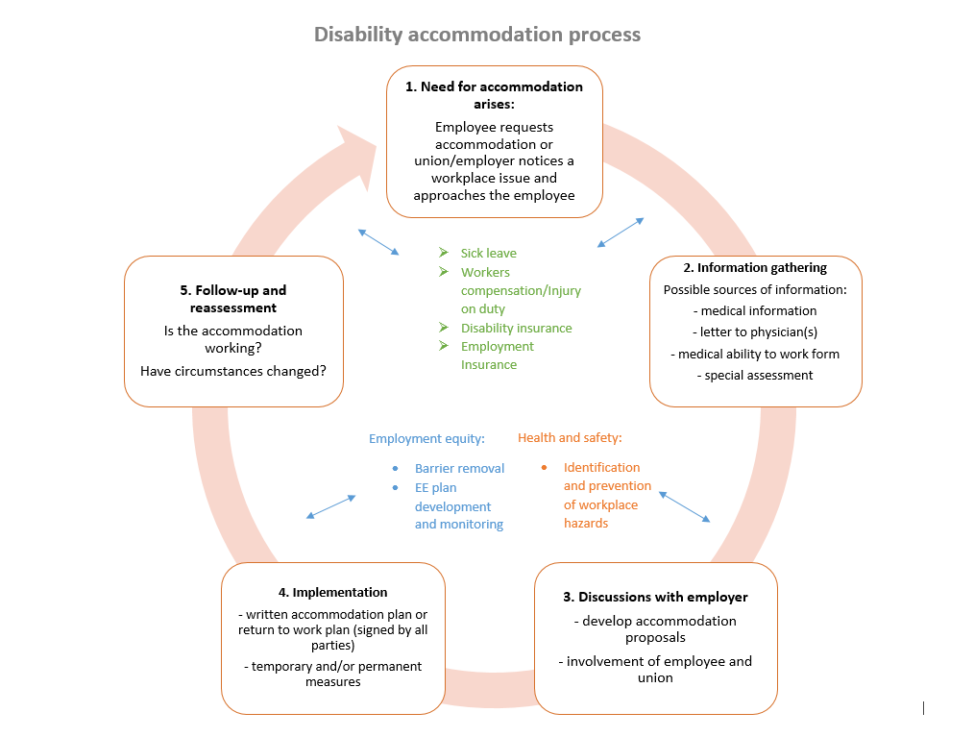
Notes:
Go through each step, using the process outlines in the longer sheet from DTA Guide.

Slide 16
Bone fide occupational requirement (BFOR)
Essential tasks required to perform the job
Not preferences
Look at performing tasks in different ways
Look at the goal of a requirement or task
Is there another way of performing the job?
Can accommodations be made?

Slide 17
Undue hardship
Not minor inconvenience
Financial costs must be significant
Costs must be for the entire organization
Health and safety must be considered
Employer must have evidence

Slide 18
Medical information
Diagnosis not required
Information relevant to the accommodation needed
Information relating to restrictions, capabilities
Employers can ask for more if they need it, but must be specific
Employee should choose which doctor to see
IME in some cases but this is not the “company doctor”

Slide 19
Recourse
Grievance (cite collective agreement and human rights legislation)
Human rights complaint (may be deferred to grievance process)
CLC Part XX
For workplace injuries, recourse under Workers Compensation legislation

Slide 20
Accommodation scenarios
What kind of an accommodation issue is this? Why?
What would be your next steps in dealing with this if you were asked for assistance or what would be your advice to a rep/steward?
Notes:
Use scenarios from the Stewards course.
Note: scenarios should be sent ahead of the webinar
Have them take a minute to review it. Then ask for answers to the questions and invite discussion.
Do the same with all of the scenarios (if there is time)

Slide 21
Resources
Component/PSAC staff
Duty to Accommodate: A PSAC Guide for Local Representatives
Other union training on the duty to accommodate
Applicable Human Rights Commission websites

Slide 22
Additional questions?
Notes:
Provide the first scenario from the Stewards course. Have them take a few minutes to read it and then discuss
Do the same with all of the scenarios (if there is time)

