Slide 1
Psychological Health & Safety in the Work Place
Jason Park
VCDS, D Safe G
UNDE Health and Safety Conference
Ottawa, Ontario
2 May 2019

Slide 2
Background - Major Drivers – Focus on Mental Health
Joint Task Force Technical Committee Reports on Mental Health in the Workplace
Clerk of the Privy Council
  Identified mental health / employee well-being as a top priority
  2016/17 key corporate commitment is “to build a respectful and health workplace with an emphasis on mental health”
Federal Public Service Workplace Mental Health Strategy
National Standard for Psychological Health & Safety in the Workplace
  A framework focused on promoting psychological health and safety in the workplace

Slide 3
Joint Task Force - Reports on Mental Health in the Workplace
Focused on measures to improve mental health in the public service and align with the National Standard
Five areas of focus:
  Leadership, Engagement, Education/Training,
  Communications and Promotion, Measurement and Accountability
Led to the Federal Public Service Workplace Mental Health Strategy

Slide 4
Federal Public Service Workplace Mental Health Strategy
Focuses on three strategic pillars:
DND/CAF will address each pillar in an action plan
Changing the Culture
Building Capacity
Measuring and Reporting

Slide 5
Federal Public Service Workplace Mental Health Strategy
Consider psychological health and safety in every aspect of work within the federal public service. Employees must feel free and able to raise concerns and seek help when they need to, in an environment that is free from stigma.
Provide the right training, tools and other resources for staff and managers to promote mental health, enhance resiliency, prevent harm, and address incidents and concerns.
Agree on a modest number of indicators that we can use to measure progress, frequently take the pulse of our organizations and our workforce, and be transparent about progress.

Slide 6
Departmental Response
The Chief of Defence Staff (CDS) and the Deputy Minister (DM) have committed “to building and sustaining a healthy, respectful and safe workplace by ensuring that the right programs and services are in place to improve the physical and mental health of Defence Team members”

Slide 7
Departmental Response
Total Health & Wellness Strategy
Defence Team Workplace Mental Health Action Plan
Focused on optimizing the workplace
  Appoint a champion
  Review data, workplace programs, policies and practices to identify risks and areas for improvement
  Raise awareness of mental health in the workplace and available workplace health support services

Slide 8
Total Health & Wellness Strategy
Part of Canada’s new Defence Policy, Strong, Secure, Engaged (SSE) “Putting People First”
A shared framework that supports the health and well-being of the Defence Team while building a safe, supportive, and respectful work environment
Promotes a culture of healthy behaviour and shared responsibility between the individual and the organization
Includes psychological well-being in the workplace, the physical work environment, and personal health, including physical, mental, spiritual and familial aspects
Notes:
Canada’s new Defence Policy, Strong, Secure, Engaged, (or SSE) outlines the Department’s commitment to support our military members, their families, as well as our civilian employees- by “putting our people first”. The Total Health and Wellness Strategy is a key component of SSE that supports the health and wellbeing of the Defence Team while building a safe, supportive, and respectful work environment.
Over the last 12 months, CMPC, ADM(HR-CIV) and VCDS have been working together and will be creating a joint “strategic framework” with common lines of effort and guiding principles with the military that will outline the Total health and wellness strategy.
The Strategy will focus on psychological well-being in the workplace (which is the National Standard for Psychological Health and Safety in the Workplace), the physical work environment (which is primarily Occupational Health & Safety), and personal health; including physical, mental, spiritual and familial aspects of employees and member’s lives.
It will promote a shared responsibility between the individual and the organization and promote a culture of healthy behaviour within the DND/CAF.
The mental health and workplace well-being of Defence civilians is critical to the success of our organization. Senior leaders, through the SSE and THWS are committed to providing employees with a healthy, supportive workplace and the mental health and other support services they require.

Slide 9
A Shared Responsibility
The health and well-being of Defence Team members is a shared responsibility of the employee and organization.
Managers play a key role
Employees also have a key role
Daily interactions count
Notes:
We believe that the health and well-being of Defence Team members is a shared responsibility between the employee and the organization
Managers and supervisors may be among the first to notice changes in behaviour that may indicate a mental health problem or illness, and play a key role in supporting their employees’ mental health issues
But we all have a responsibility – regardless of our position in the organization – from encouraging people to talk about and take care of mental health, to having someone living with a mental illness feel they are not alone, to encouraging someone to reach out for help
Daily interactions count when it comes to creating a healthy and respectful work environment
This is why raising awareness of mental health issues and activities such as today’s forum are so important

Slide 10
National Standard for Psychological Health & Safety in the Work Place
A voluntary Occupational Health and Safety Standard
Focused on promoting employees’ mental health and preventing mental injury due to factors that are within the control, responsibility, or influence of the workplace
Helps shift organizational culture to support psychological health

Slide 11
National Standard for Psychological Health & Safety in the Work Place
13 Factors
1 - Psychological Support | 8 - Involvement & Influence
2 - Organizational Culture | 9 - Workload Management
3 - Clear Leadership & Expectations | 10 – Engagement
4 - Civility & Respect | 11 – Balance
5 - Psychological Job Demands/Competencies and Requirements | 12 - Psychological Protection
6 - Growth & Development | 13 - Protection of Physical Safety
7 - Recognition & Reward

Slide 12
Defence Workplace Wellbeing Survey
Department-wide workplace well-being assessment (CAF members and DND civilian employees)
Stratified random sample to produce a well-being profile that is representative of DND
Supports:
  the Federal Public Service Workplace Mental Health Strategy
  the Defence Total Health and Wellness Strategy
  departmental reporting requirements
Provides a heat map across Defence – guides where to focus interventions

Slide 13
Defence Workplace Wellbeing Survey
Aligned with the national standard
Action-oriented
Versatile – Can adjust to Defence needs
DND retains the data – greater research & analysis potential, accessible, customizable reports, secure
Evidence-based and supported by internationally recognized experts
Provides an integrated snapshot of well-being across the Defence Team
Conducted by public service employees, for public service employees/CAF members

Slide 14
Defence Workplace Wellbeing Survey
We are influencing other federal government departments
Employment and Social Development Canada compared the DWWS against PSES and GuardingMinds@Work
  Concluded that DWWS was the best option for them
  Piloted Jan 2017
  Administered department-wide Feb/Mar 2017
Statistics Canada, Public Services and Procurement Canada, and Health Canada have expressed interest.

Slide 15
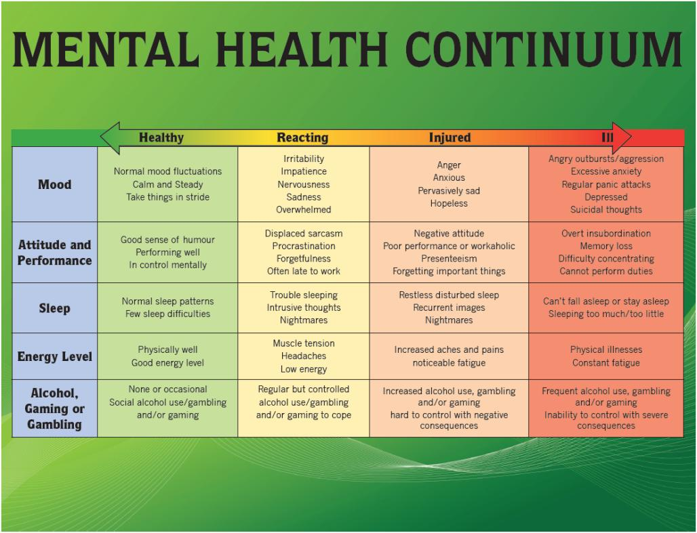
Notes:
- Some of us are familiar with the Mental Health Continuum, which encourages all Defence Team members to stay mentally healthy
To be at our best, we need to take are of our mental health just as we do our physical health
Check in with yourself. Ask yourself how are you doing? And use the continuum as a guide.

Slide 16
Mental Health Continuum Model
Mental health can shift day to day
Everyone falls along this continuum
Not a diagnostic tool, more for self awareness
Identify actions to optimize your mental health
Guide to help identify distress in your colleagues
Notes:
The Mental Health Continuum was developed by the Canadian Armed Forces in collaboration with the United States Marine Corps in 2008 to reflect the fact that health, be it physical or mental health, is a dynamic changing state that can deteriorate or improve given the right set of circumstances. The arrow acknowledges movement in both directions, creating an expectancy of return to full health and functioning, and encouraging earlier access to care.

Slide 17
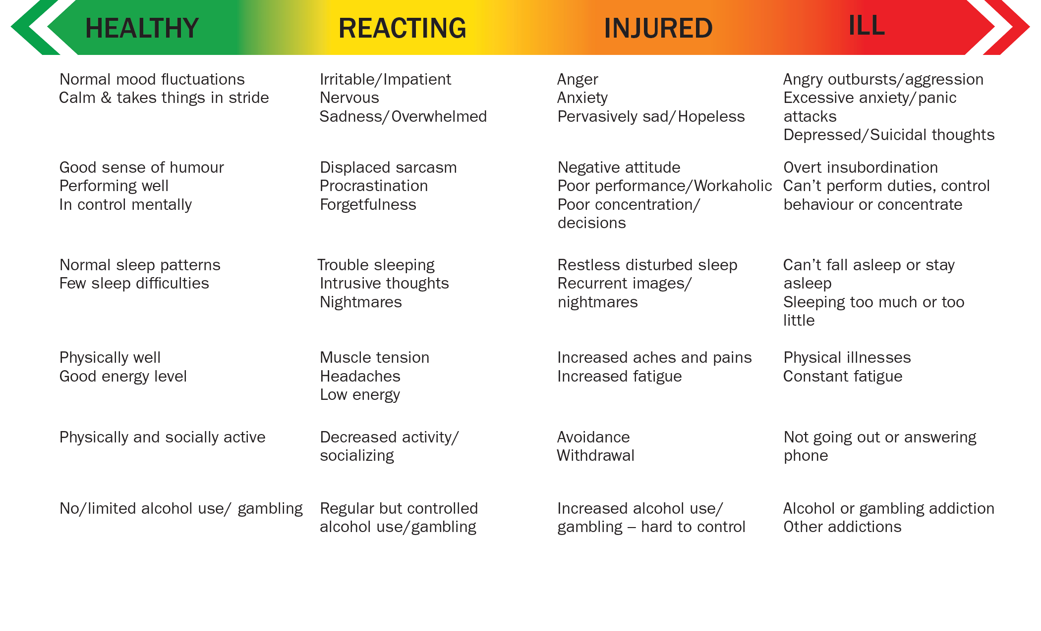
Monitor your mental health
Notes:
In order to help individuals recognize symptoms of distress in themselves and others, the continuum was developed using common behaviours that might be observed whether at work or at home. This provides everyone with the ability to self-monitor, recognize when their early indicators of distress, and take action to regain a healthier level of functioning. The continuum is also helpful is differentiating when we can likely manage on our own (the left side of the continuum) and when we need to seek additional resources.

Slide 18
Living in the Green: Individual Actions
Break large tasks into smaller steps
Focus on one task at a time
Slow down your breathing
Challenge negative self talk
Maintain healthy lifestyle
Prioritize quality sleep
Nurture a support system
Recognize limits and take breaks
Make time for relaxation, recreation
Notes:
As a shared responsibility, the individual, their peers and colleagues, as well as their managers and supervisors each play a role in ensuring health and well-being. As individuals, here are some things that we can do to maintain our health.
Maintain a healthy lifestyle – Diet and exercise are always important and build a foundation of health and well-being
Good sleep hygiene – Quality sleep affects how we manage the demands of our daily lives, and can influence our perception and reactions to day to day stressors
Nurture a support system – Seeking support from others is key and one of the main factors that may mitigate the impact of stress;
Recognize limits and take breaks – If we continue to push ourselves without taking the necessary break, we can push ourselves further along the continuum. There is a reason we have vacation – we need to use these breaks.
Rest, relaxation, recreation: recreational activities and relaxation play a key role in sustaining performance over the long term.

Slide 19
Living in the Green: Colleague/Workplace Actions
Set a positive example for others
Provide peer support
Be respectful and civil to others
Be inclusive
Communicate positively and openly
Check in with each other
Listen attentively
Notes:
Our behavior has an impact on others, and can help create a healthier work environment.
Set a positive example for others – use the skills we just discussed
Peer support – what does peer support involve?
Check in with each other – ask each other “how are you doing?” if someone is struggling ask “Is there anything I can do to help?”
Listening is one of the most important communication skills – included in listening is acknowledging what the person is saying and clarifying anything you don’t understand.
Normalize feelings - that stress impacts us all and it is normal to be in the yellow zone during periods of stress
Respect – How do we contribute to problems in the workplace? Consider that rumours and gossip only get spread if people pass them on.
Be inclusive – get together for lunch and events and include all members of the unit
Communication – keep lines of communication open and ensure you communicate your concerns respectfully, and are open to what others have to say

Slide 20
Living in the Green: Leader Actions
Lead by example – use individual strategies
Get to know your team
Foster a healthy work climate
Identify and resolve problems early
Deal with performance issues promptly
Demonstrate genuine concern
Encourage work-life balance
Recognize effort & contribution
Notes:
Leaders at all levels can have a significant impact on how people perceive their workplace and the demands placed on them, as well as how they cope with those demands.
Lead by example - Accountability for one’s own well-being is strengthened by the example set by leadership.
Get to know your personnel – Leaders are taught about the importance of communication skills such as listening, putting the person at ease, how to get them talking – all of these skills are essential to create a climate of support with your personnel, both in good times and bad. If you develop a good relationship with your staff when times are good, they are more likely to communicate with you and come to you when times are bad.
Foster healthy climate – This is a key element to promote mental well-being in subordinates
Be flexible - for example, in work hours or in applying compassionate leave
Schedule breaks and ensure members take them
Get together for team activities (such as coffee, lunch, sports day)
Open door policy – allow the opportunity for your troops to approach you
Approach your members - walk around and see people in their environment – know what they do during the day – don’t wait for them to approach you
Get to know your subordinates
Ensure efficient flow of information
Demonstrate concern for their well-being
Set achievable goals for unit and members
Acknowledge success and reward performance
Identify and resolve problems early - Be proactive; don’t wait for problems to develop or deteriorate - Proactive role in fostering a climate that supports the early identification and referral of distressed personnel.
Deal with performance issues promptly – You don’t do your subordinate any favours by ignoring the poor performance. In fact, for many of us, getting constructive feedback and assistance helps us to maintain a positive level of health.
Demonstrate genuine concern - the leader’s influence rests on the member’s knowledge that he or she is available when needed. This speaks to the importance of being approachable as a leader. They will only come to you in times of difficulties if you have given the message that you are willing to listen, able to help them and care about their well-being.

Slide 21
Mental Health Resources (Civilian)
Online training (offered via the Defence Learning Network)
  Mental Health in the Workplace for Managers (and Employees)
In-class training (offered via the regional Learning and Career Centres and Health Promotions)
  The Crucial Conversation
  JLP Mental Health in the Workplace
The Employee Assistance Program (EAP)
  Active listening services and referral services provided by internal Referral Agents (RAs)
  Short-term counselling services provided by professional mental health counsellors (HC-EAS)
Conflict Resolution Program – Alternative Dispute Resolution
Centre of Expertise for Mental Health in the Workplace website
Not Myself Today® 2017 Pilot Program
Notes:
- As an organization, we need to give people the tools to cope with issues at work, and at home.
- There are many resources available to you, such as:
- Online training – via the Defence Learning Network specifically,
- Mental Health in the Workplace for Managers and for Employees
- Creating a Respectful Workplace
- And other courses offered online through the Canada School of Public Service
- Classroom training at your Learning & Career Centres:
- Crucial Conversation – ½ day course – goal – to enable managers to practice having conversations and raising sensitive issues with employees experiencing mental health issues
- Your local LCC also offers the 2 day JLP (Joint Learning Program) Mental Health in the Workplace classroom course
- Health Promotions also offers courses for both civilian and military
EAP – Referral Agents across the country provide support and referral services – as well as access to mental health professionals though Health Canada’s EAS 1-800 service.
- The Centre of Expertise for Mental Health in the Workplace – on the TBS website is an excellent resource of information
We will also be piloting the Not Myself Today campaign across the department – which is a workplace mental health initiative that equips managers and employees with information, tools and resources to help build a mentally healthy workplace
Over the next few months, you will see communications from the PA team on mental health, using
- This initiative is focused on 3 outcomes:
Building awareness and understanding of mental health
Reducing stigma
Fostering safe and supportive work cultures
Which ties in very closely to our goal for this fiscal year – in raising awareness of mental health and building safe, healthy and supportive work environments.

Slide 22
Questions?

